Slide 1
Renal case
By Dr/ Ekram Abd El Rahman Mahmoud

Slide 2
A 21 years old woman presented to the office with 3 days duration of discomfort with urination and increased urinary frequency. She noted that her urine has a strong odor as well. On abdominal examination suprapubic tenderness was noted. Microscopic examination of the sediment of a centrifuged urine sample reveals 10-15 white blood cells per high power field and numerous bacteria. By culture on both macConkey and EMB media the growth appear as shown in the following picture

Slide 3
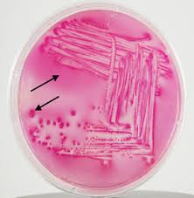
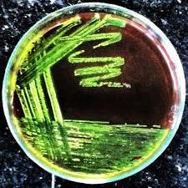

Slide 4
1- What is the diagnosis of this case?
2- What type of organism would a Gram stain of the urine likely show?
3- What is the etiologic agent of this infection?
4- What is the most likely reservoir of this infection?
5- What is the most likely mechanism by which this organism cause this infection?

Slide 5
1- What is the diagnosis of this case?
A case of UTI
2- What type of organism would a Gram stain of the urine likely show?
Gram negative bacilli
3- What is the etiologic agent of this infection?
E.coli

Slide 6
4- What is the most likely reservoir of this infection?
the patient own gastrointestinal tract
5- What is the most likely mechanism by which this organism cause this infection?
urethral contamination by colonic bacteria followed by ascending of the infection Into the bladder

Slide 7
6- Is the risk of this infection equal in both male & female? Why?
7- What is the number of this bacteria in the urine to considered significant?
8- What is the virulence factors of this organism?
9-How confirm your causaitive organism by biochemical reactions?

Slide 8
6- Is the risk of this infection equal in both male & female? Why?
Women are at greater risk of developing UTI than men due to 3 features facilitate ascending infection to the bladder
1- short urethera
2- proximity of the urethera to the anus
3- colonization of the vagina by members of faecal flora.

Slide 9
7- What is the number of this bacteria in the urine to considered significant?
presence of ⩾10⁵ CFU/ml of urine.
8- What is the virulence factors of this organism?
A- Pili with adhesin proteins bind to specific receptors on urinary tract epithelium.
B- Motility of E.coli aid to ascend through urinary tract.

Slide 10
9-How confirm your causaitive organism by biochemical reactions?
Indole +
Methyl red +
Voges-Proskauer (VP) –
Citrate -

Slide 11
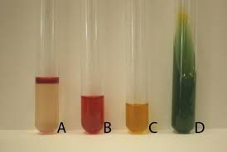
IMViC series done on Escherichia coli
IMViC of Escherichia coli

Slide 12


